Slide 1
Software Verification & Validation
Part 1 - Psychology and
Economics of Testing

Slide 2
Check for Understanding
½ half sheet of paper (individual)
This is usually caused by the user mistakes.
This a deviation from expected result which leads to failures.
What’s the purpose of SOFTWARE TESTING?
Identify 1 bad practice of developers when it comes to software testing.
Differentiate VERIFICATION and VALIDATION.
Give 2 principles of testing and explain.
Why do most software fail? (Give 3 reasons)

Slide 3

Ineffective Attitude to Testing
Testing is the process of showing that the programs works.
Testing is the process of establishing confidence that a program does what it’s supposed to do

Slide 4
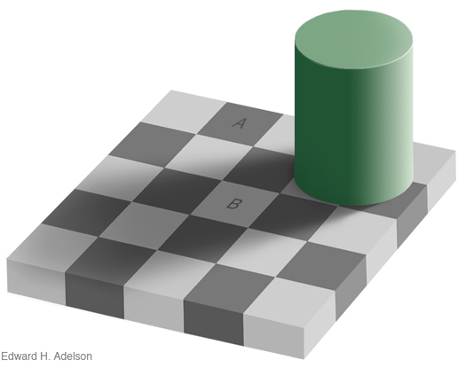
You see what you expect to see!

Slide 5
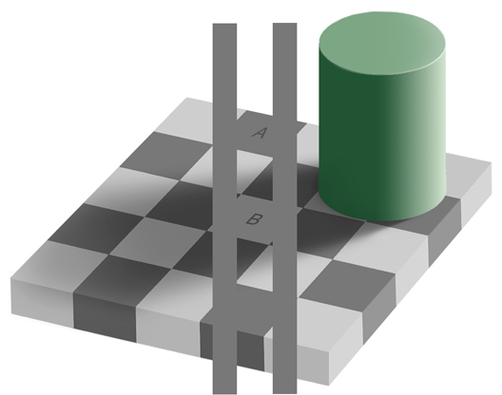
You see what you expect to see!

Slide 6
Psychological Effect
My goal is to prove the program works. I expect the program to do what it’s supposed to do.
# of Errors Found
My goal is to prove the program is no good. I expect the program to fail a lot.
# of Errors Found

Slide 7

Improved Attitude on Testing
We test to find errors and get them fixed. A test is only successful if it uncovers software flaws.

Slide 8

Testing Analogy
A test that does not reveal a problem
is a waste of time.

Slide 9
Economics of Testing
Is it possible to find all errors in a program? Can we test a program completely?
Ans: Negative.
Even for trivial programs.

Slide 10
Economics of Testing
Why is it impossible?
Too Large.
Too Many.
Too Complex.

Slide 11
Economics of Testing
Too Large
All valid inputs.
All invalid inputs.
At every point of entry
Under every state of the program
Story 1 – Database Management
Story 2 – Word processor

Slide 12
Economics of Testing
Too Many Paths
1
2
5
6
3
4
Story 3 – PBX telephone system

Slide 13
Economics of Testing
Too Many Paths
Idle
Call Waiting
Ringing
Disconnected
Connected
On Hold
Story 3 – PBX telephone system

Slide 14
Economics of Testing
Too Many Paths – Even simple programs
Myer’s Program (1979) Loop and few if statements (20 lines of codes)
Results to 100 trillion paths.
A fast tester can test them in a billion years!
Imagine testing a Java compiler then!

Slide 15
Economics of Testing
Too Complex
After you find bugs and getting them fixed – you will have to run tests again! Which often leads to finding more bugs.
How many rounds of testing should you run then?

Slide 16
Economics of Testing
Fundamental Question
What heuristics and strategies can we use to select the tests that will reveal the most number of defects, errors and flaws under a limited number of time and people?

Slide 17
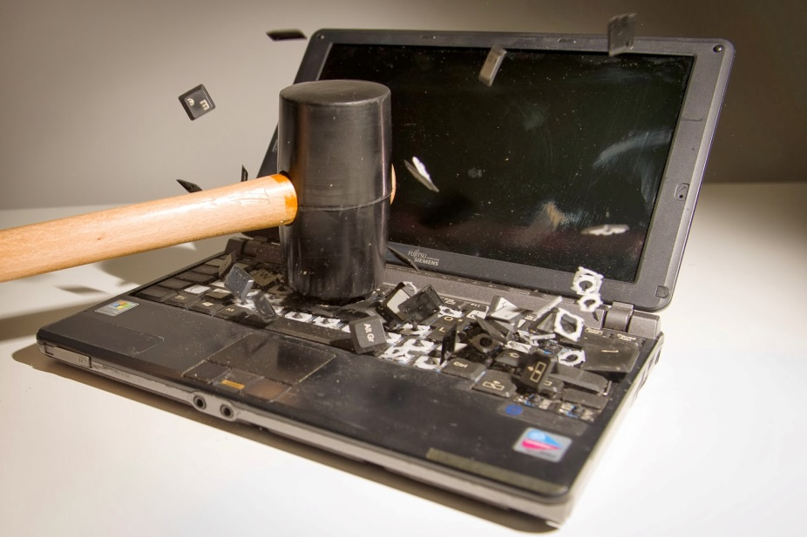
Principles of Testing
Principle #1
Plan a testing effort with a destructive attitude on the software.
Easy!

Slide 18

Principles of Testing
Principle #2
A programmer should avoid testing his or her own program.
Testers
Programmer

Slide 19
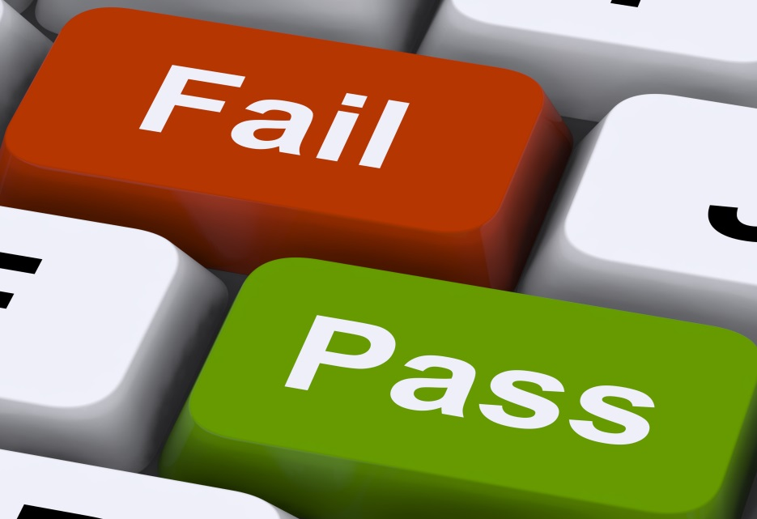
Principles of Testing
Principle #3
Check whether the program does what it should do and what it should not do.

Slide 20
Principles of Testing
Principle #4
Errors tend to come in clusters. Some sections of the software will be more error-prone compared to others.

Slide 21
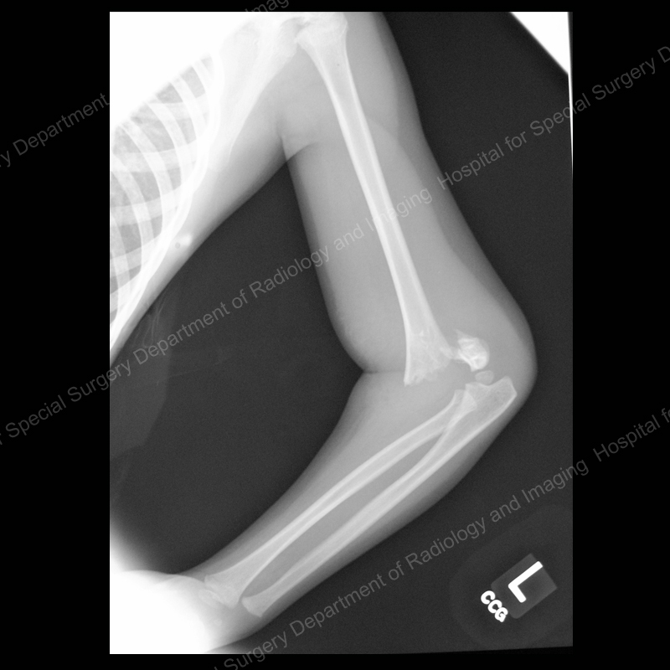
Principles of Testing
Principle #5
A necessary part of a test case is a clear definition of the expected output or result

Slide 22

Principles of Testing
Principle #6
Successful testing includes careful study of the result.

Slide 23
We want Quality Testing
Effective
Use a strategy that uncovers as many defects as possible
Efficient
Find the largest possible number of defects using the fewest possible tests

Slide 24
Software Testing
Intellectually challenging
extremely
creative

Slide 25
Checkpoint
Can you identify part/s of your thesis/course project that will yield the most errors?
Why do you think so?

